Slide 1

(Chapter 3) Agile Software Development
Department of Computer Science and Engineering
School of Engineering, Presidency University

Slide 2
Chapter 3 - Contents
Manifesto for Agile Software development
What is “Agility”?
Agility and the Cost of Change
Agile Process and Principles
Agile Models
Extreme Programming (XP)
Adaptive Software Development (ASD)
Scrum
Feature Driven Development
Agile Modelling
Criteria for selecting the right Process Model

Slide 3
1. Manifesto for Agile S/W Development
“We are uncovering better ways of developing software by doing it and helping others do it. Through this work we have come to value:
Individuals and interactions over processes and tools
Working software over comprehensive documentation
Customer collaboration over contract negotiation
Responding to change over following a plan
That is, while there is value in the items on the right, we value the items on the left more.”
- Kent Beck et al.

Slide 4
2. What is “Agility”
Effective (rapid and adaptive) response to change
Effective communication among all stakeholders
Drawing the customer onto the team
Organizing a team so that it is in control of the work performed
Yielding …
Rapid, incremental delivery of software

Slide 5
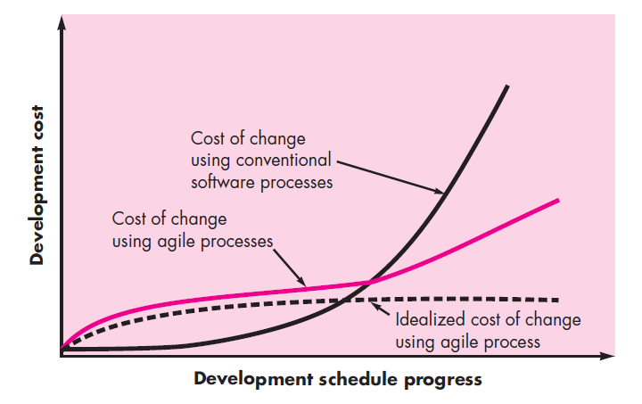
3. Agility and the Cost of Change

Slide 6
4. An Agile Process
Is driven by customer descriptions of what is required (scenarios)
Recognizes that plans are short-lived
Develops software iteratively with a heavy emphasis on construction activities
Delivers multiple ‘software increments’
Adapts as changes occur

Slide 7
Agile Principles - I
1. Our highest priority is to satisfy the customer through early and continuous delivery of valuable software.
2. Welcome changing requirements, even late in development. Agile processes harness change for the customer's competitive advantage.
3. Deliver working software frequently, from a couple of weeks to a couple of months, with a preference to the shorter timescale.
4. Business people and developers must work together daily throughout the project.
5. Build projects around motivated individuals. Give them the environment and support they need, and trust them to get the job done.
6. The most efficient and effective method of conveying information to and within a development team is face–to–face conversation.

Slide 8
Agile Principles - II
7. Working software is the primary measure of progress.
8. Agile processes promote sustainable development. The sponsors, developers, and users should be able to maintain a constant pace indefinitely.
9. Continuous attention to technical excellence and good design enhances agility.
10. Simplicity – the art of maximizing the amount of work not done – is essential.
11. The best architectures, requirements, and designs emerge from self–organizing teams.
12. At regular intervals, the team reflects on how to become more effective, then tunes and adjusts its behavior accordingly.

Slide 9
Human Factors
The process molds to the needs of the people and team, not the other way around
Key traits must exist among the people on an agile team and the team itself:
Competence.
Common focus.
Collaboration.
Decision-making ability.
Fuzzy problem-solving ability.
Mutual trust and respect.
Self-organization.

Slide 10
5. AGILE MODELS 5.1 Extreme Programming
The most widely used agile process, originally proposed by Kent Beck
XP Planning
Begins with the creation of “user stories”
Agile team assesses each story and assigns a cost
Stories are grouped to form a deliverable increment
A commitment is made on delivery date
After the first increment “project velocity” is used to help define subsequent delivery dates for other increments

Slide 11
Extreme Programming
XP Design
Follows the KISS principle
Encourage the use of CRC cards
For difficult design problems, suggests the creation of “spike solutions” - a design prototype
Encourages “refactoring” - an iterative refinement of the internal program design
XP Coding
Recommends the construction of a unit test for a user story before coding commences
Encourages “pair programming”
XP Testing
All unit tests are executed daily
“Acceptance tests” are defined by the customer and executed to assess customer visible functionality

Slide 12
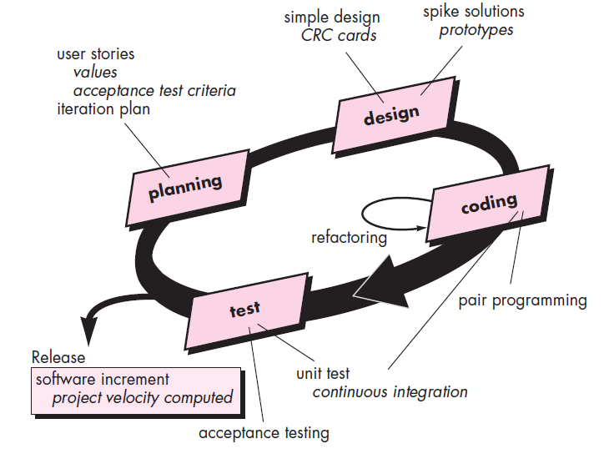
Extreme Programming Process

Slide 13
5.2. Adaptive Software Development (ASD)
Originally proposed by Jim Highsmith for building complex software and systems.
Distinguishing features of ASD:
Mission-driven planning
Component-based focus
Uses “time-boxing”
Explicit consideration of risks
Emphasizes collaboration for requirements gathering
Emphasizes “learning” throughout the process

Slide 14
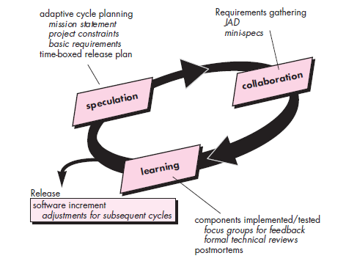
Adaptive Software Development (ASD)

Slide 15
5.3. SCRUM
Originally proposed by Schwaber and Beedle
Scrum—distinguishing features
Development work is partitioned into “packets”
Testing and documentation are on-going as the product is constructed
Work occurs in “sprints” and is derived from a “backlog” of existing requirements
Items can be added to backlogs anytime, introducing changes to the system.
Meetings are very short and sometimes conducted without chairs
“demos” are delivered to the customer with the time-box allocated

Slide 16
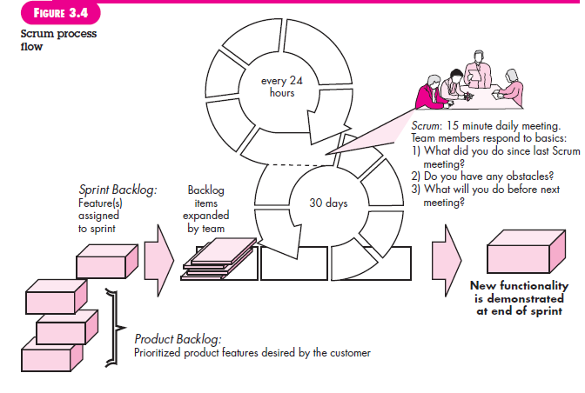
SCRUM

Slide 17
5.4. Feature Driven Development
Originally proposed by Peter Coad et al
FDD - distinguishing features
Emphasis is on defining “features”
a feature “is a client-valued function that can be implemented in two weeks or less.”
Feature is a small block of deliverable functionality
Uses a feature template
<action> the <result> <by | for | of | to> a(n) <object>

Slide 18
5.4. Feature Driven Development
Uses a feature template
<action> the <result> <by | for | of | to> a(n) <object>
Ex 1: Add the Product to shopping cart
Ex 2: Display the technical specifications of the product
Ex 3: Store the shipping information for the customer
A features list is created and “plan by feature” is conducted
Design and construction merge in FDD

Slide 19
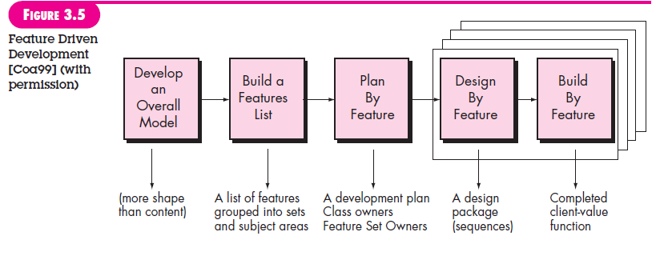
Feature Driven Development
Design walkthrough, Design, Design Inspection, Code, Code inspection

Slide 20
6. Agile Modelling
Originally proposed by Scott Ambler
Is a practice-based methodology for effective modeling and documentation of software-based systems
Suggests a set of agile modeling principles
Model with a purpose
Use multiple models
Travel light
Content is more important than representation
Know the models and the tools you use to create them
Adapt locally

Slide 21
7. Criteria for selecting the right Process Model
Factors | Waterfall | V-Shaped | Evolutionary Prototyping | Spiral | Iterative and Incremental | Agile
Unclear User Requirement | Poor | Poor | Good | Excellent | Good | Excellent
Unfamiliar Technology | Poor | Poor | Excellent | Excellent | Good | Poor
Complex System | Good | Good | Excellent | Excellent | Good | Poor
Reliable system | Good | Good | Poor | Excellent | Good | Good
Short Time Schedule | Poor | Poor | Good | Poor | Excellent | Excellent
Strong Project Management | Excellent | Excellent | Excellent | Excellent | Excellent | Excellent
Cost limitation | Poor | Poor | Poor | Poor | Excellent | Excellent
Visibility of Stakeholders | Good | Good | Excellent | Excellent | Good | Excellent
Skills limitation | Good | Good | Poor | Poor | Good | Poor
Documentation | Excellent | Excellent | Good | Good | Excellent | Poor
Component reusability | Excellent | Excellent | Poor | Poor | Excellent | Poor

